Slide 2
DIVISION OF RESEARCH AND INNOVATION (DORI) How can DORI serve you? Rachel Wallace, PhD Assistant Vice President, Research Development September 13, 2024
research.wayne.edu

Slide 3
DORI Overview
Who we are
Research Integrity
Services & Support
Communications
Proposal Development
& Submission
research.wayne.edu

Slide 4
Our commitment
Oversight
& direction
Facilitation
& stimulation
Support
Development
Guidance
Compliance
research.wayne.edu

Slide 5
"Our Moment in Time" Strategic Plan for Wayne State University 2022-2027
Advance research initiatives to address local, regional and global societal challenges
Further develop enabling technologies, infrastructure and workflow systems to support scholarly activity
Increase research awards and expenditures
Expand recognition of scholarly and creative activity
research.wayne.edu

Slide 6
WSU Profile Urban research, teaching, & service mission
Embedded in the heart of Detroit → support the health and well-being of our region
RI: Research expenditures of $250.9M (NSF FY2023)
Minority Serving Institution (MSI), & Community Engaged Institution (CEI)
Member of the University Research Corridor comprised of MSU, U-M, & WSU
research.wayne.edu

Slide 7
DORI Leadership Team
Dr. Ezemenari
M. Obasi
Vice President
Ashley Hysell
Executive Assistant
Julie
O’Connor
Director
Daisy
Wright
Senior Director
Dr. Philip Cunningham
Associate Vice President
Open
Assistant Vice President
Dr. Phillip
Levy
Associate Vice President
Dr. Rachel
Wallace
Assistant Vice President
Taunya
Phillips
Assistant Vice President
Research Communications
Business Operations
BAO
Research Integrity Office
RIO
Sponsored Program Administration
SPA
Translational Science
Research Development Office
RD
Office of Technology Commercialization
OTC
Lewis-Burke Associates
Federal Relations
research.wayne.edu

Slide 8
6 DORI Centers & Institutes
Ezemenari M. Obasi, PhD
Vice President
Melissa Runge-Morris, MD
Director
Lawrence Grossman, PhD
Director
Thomas Jankowski, PhD
Interim Director
Alissa Huth-Bocks, PhD
Director
Drs. Rosenberg & Damoiseaux
Co-Directors
Drs. Chopra, Kilgore, Seeger, & Zervos
Co-Directors
Institute of Environmental Health Sciences
IEHS
Molecular Medicine & Genetics
MMG
Institute of Gerontology
IOG
Merrill Palmer Skillman Institute
MPSI
Institute of Brain Health
IBH
Center for Emerging & Infectious Diseases
CEID
research.wayne.edu
Notes:
Six CIAC-II Centers at WSU
Two new centers
Ben L. Silberstein Institute for Brain Health
Center for Emerging and Infectious Diseases
Plans for more robust, equitable, and centralized support are in progress

Slide 9
16 DORI Research Cores
Access to High Level Instrumentation and Support: Cores/Facilities directed by OVPR provide service, equipment and specialized training on research instrumentation available to WSU.
Analytic Tools to Support Research Efforts: Statistical support provided to enhance the analytical aspects of research efforts.
Biobank Support and Opportunities: Access to biological specimens that enhance research opportunities and align with community / population-based research efforts.
Support a Broad Spectrum of Different Research Samples: Study samples ranging from small molecules to large mammals.
research.wayne.edu

Slide 10
16 DORI Research Cores
Animal Facilities (DLAR)
Biomedical Imaging (MRI, PET)
Biospecimen Repository (BioBank)
Clinical Research Services Center
Community Engaged Research
Genome Sciences Core
Lipidomics Core
Lumigen Instrument Center
Microscopy & Cytometry
Protein/Molecular Structural Analysis
Pharmacogenomics Resource Laboratory (PGRL)
Proteomics Core
ResearchOne
Research Data Management Services
Statistical Services
Wayne Integrated Research Lab (WiRL)
research.wayne.edu

Slide 11
Cores and Centers/Institutes
Centers & Institutes
https://research.wayne.edu/centers-institutes
Research Cores
https://research.wayne.edu/cores-facilities
research.wayne.edu
Notes:
Approx 18 cores across campus
6 centers and institutes that report to OVPR

Slide 12
Sponsored Program Administration (SPA)
Institutional oversight of sponsored research programs
Faculty
University
Sponsors
research.wayne.edu

Slide 13
Sponsored Program Administration (SPA)
Institutional oversight of sponsored research programs
Proposal preparation
Insight into sponsor rules and guidelines
Advise on how best to meet the goals of the project
Negotiation to ensure faculty are protected
Point of contact for the faculty and the sponsors
Alignment with WSU guidelines and policies
Proposal review to protect University interests
Availability of WSU’s committed resources
Serve as stewards, ensuring funds are used appropriately.
Primary point of contact for questions or other issues throughout the project life cycle
Faculty
University
Sponsors
research.wayne.edu

Slide 14
Sponsored Program Administration (SPA) Submit proposals through spa!
The hill I will die on…
Proposals
SPA
Sponsor
All proposals must be submitted to SPA – and loaded into Cayuse –
5 business days before the application deadline.
research.wayne.edu

Slide 15
Sponsored Program Administration (SPA) Submission Deadline Policy
https://research.wayne.edu/spa/submissionpolicy
Earlier is better!
“Standard” proposal: 3 business days
2 extra days for proposals with binding terms upon award
Late proposals: <3days
Reasonable effort to submit, not guaranteed
At risk proposals: <24 hours until submission deadline
Requires endorsement from Associate Dean for Research
research.wayne.edu

Slide 16
Research Development Office (RD) Dr. Rachel Wallace – AVP for Research Development rlwallace@wayne.edu
Internal funding programs
Large-scale proposal development
Limited submission competitions
Proposal resources
Identifying external funding opportunities
Strategic research planning/design
Workshops and webinars
research.wayne.edu

Slide 17
Research Development Office (RD) Collaboration with Grant/Research Administrators
credit: JILL JIVIDEN and JESS BRASSARD (University of Michigan)
research.wayne.edu

Slide 18
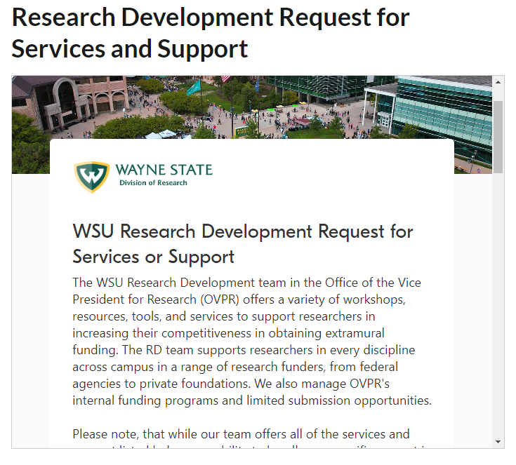
Research Development Office (R&D) Request Help
https://research.wayne.edu/development/request
researchdevelopment@groups.wayne.edu
research.wayne.edu

Slide 19
Research Development Office (RD) Cost-Share, Institutional Letters of Support
OVPR Cost Share Request: https://wayne.infoready4.com/#competitionDetail/1908206
Proposals with a mandatory cost-sharing requirement
Requests for voluntary cost-sharing will not be considered
Institutional Letter of Support
research.wayne.edu

Slide 20
Research Development Office (RD) Limited Submission Opportunities
LSO: funding programs in which the sponsor only accepts a limited number of applications per institution, and so the institution must run an internal competition to select the applicant(s)
Recurring
(annual)
New!
research.wayne.edu

Slide 21
Research Development Office (RD) AY2024-2025 Internal Funding Opportunities
Funding programs with set deadlines
Arts and Humanities Research Support
Announced soon! LOI deadline late Fall
Info session: October 9, 12-1 pm, Zoom
Social Sciences Research Support
Announced soon! LOI deadline late Fall
Info session: October 9, 12-1 pm, Zoom
Faculty Competition for Postdoctoral Fellows
Due date: November 6, 2024
Grant Advance (resub. and renewal bridge funds)
Due date: November 15, 2024; Winter Semester 2025
Continuous/rolling funding programs
Pre-Submission Review (internal and external)
DORI Cost Share Request
research.wayne.edu

Slide 22
Research Development Office (RD) AY2024-2025 Seminars, Townhalls, and Trainings
GrantForward Training Workshop
September 19, 12-1 pm, RSVP
October 30, 1-2 pm, RSVP
Health/Biomed Webinar with LBA
October 8, 2024, 12-1 pm, announcement soon!
National Endowment for the Humanities – in person!
October 23-24, opportunity for 1:1 with PO, Register
Write Winning Grant Proposals w/ Grant Central
January 21 & 22, 1-4:30 pm, announcement soon!
NIH Renewals and Resubmissions w/ Grant Central
January 23, 8:30 am-12 pm, announcement soon!
Other potential seminars: new equipment on campus; DMS plans; large-scale proposal development; a variety of RD topics (e.g., communicating science, intro to tech transfer, how to talk to program officers, etc.)
Have an idea for a topic? Let us know! (researchdevelompent@groups.wayne.edu)
research.wayne.edu

Slide 23
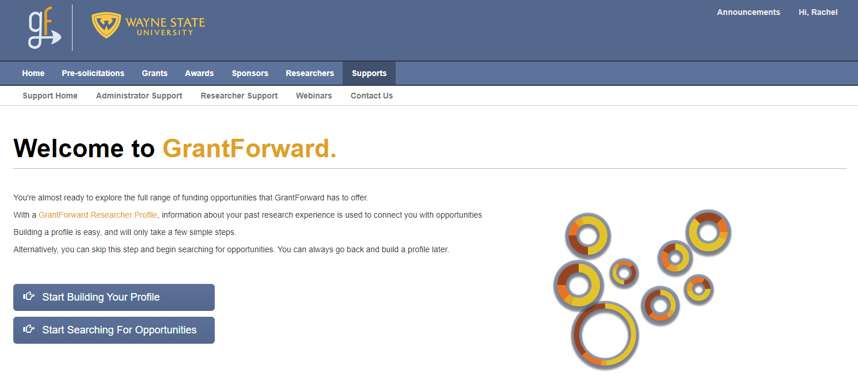
Research Development Office (RD) Finding Funding Opportunities
grantforward.com/saml/wsu
research.wayne.edu

Slide 24
Research Integrity Office (RIO) Dr. Philip Cunningham – AVP for Research Integrity
philc@wayne.edu
Research Ethics
Research Safety
research.wayne.edu

Slide 25
Research Integrity Office (RIO) RIO is here to support faculty research
Human Subjects Research: Institutional Review Board (IRB)
Animal Research: Institutional Animal Care & Use Committee (IACUC)
Laboratory Safety: Office of Environmental Health & Safety (OEHS)
Financial Conflict of interest (FCOI)
Export Control
Research involving national security
Research Misconduct
research.wayne.edu

Slide 26
Office of Technology Commercialization (OTC) Taunya Phillips – AVP for Tech Commercialization taunya.phillips@wayne.edu
Technology Commercialization is responsible for the identification, protection, marketing and licensing of university-owned intellectual property (patents, unique biological or other materials, and certain copyrights) created by WSU faculty, staff and students.
research.wayne.edu

Slide 27
Office of Technology Commercialization (OTC) OTC is here to faculty innovation
Assistance and support through the innovation disclosure process
Identifying protectable intellectual property
Completing disclosure documents
Support through the patenting process
Liaison between the innovator and patent law firms
Agreements for protection of shared information and conversations
Non-Disclosure Agreements (NDAs)
Agreements for the transfer of materials and information
Material Transfer Agreements (MTAs)
Data Use Agreements (DUAs)
research.wayne.edu

Slide 28
Office of Technology Commercialization (OTC) Additional services that are provided
Facilitation of the commercialization process
Market analysis
Licensing to university start-ups
Connections to experienced/mentor entrepreneurs
Support for early-stage technology development grants (SBIR/STTR, MTRAC)
Support for entrepreneurial training (NSF i-Corps, Tech Town)
Industry engagement
Licensing technology to existing companies
Enable research connections with industry
research.wayne.edu

Slide 29
Office of Technology Commercialization (OTC) Additional services that are provided
Faculty education on the various aspects of technology commercialization
Seminars – department, college, center, institute
Webinars
Entrepreneurial Culture Building
Promotion and celebration of WSU innovation, campus-wide and beyond
research.wayne.edu

Slide 30
Research Communications Office
Julie O’Connor – Director of Research Communications julie.oconnor@wayne.edu
Research Communications promotes research programs, events, and news.
Email
blasts
Press releases
Media advisories
Web presence
Research newsletters
Social
media
research.wayne.edu

Slide 31
THANK YOU!
Ezemenari M. Obasi, PhD
VP, Research & Innovation (VPRI)
vpr@wayne.edu
Philip Cunningham, PhD
AVP, Research Integrity (RIO)
philc@wayne.edu
Taunya Phillips
AVP, Technology Commercialization (OTC)
taunya.phillips@wayne.edu
Phil Levy, MD, MPH
AVP, Translational Science
plevy@med.wayne.edu
Julie O’Connor
Director, Research Communications
julie.oconnor@wayne.edu
TBH
AVP, Sponsored Program Administration (SPA)
Rachel Wallace, PhD
AVP, Research Development (R&D)
rlwallace@wayne.edu
Daisy Wright
Sr. Director, Business Affairs Officer (BAO)
daisy.wright@wayne.edu
research.wayne.edu

